Slide 1
Project 9 Demo
Beacon-Based IoT System Use in the Office
Sumin Sohn
Taeyeon Kim
Jinhyeok Jeon
Sean Gomez
Seockwoo Lee
Taehoon Ha
Byeongjin Kim

Slide 2
Team Purpose
Using Beacons
Identify the user’s real-time Location
To Application User
General
Give information
(about office)
Emergency
(Fire)
Sending a fire evacuation message

Slide 3




Progress status of the project
Overview
Database
(Firebase)
Beacons
Application
(Android)
Raspberry Pi
(with Sensor)

Slide 4

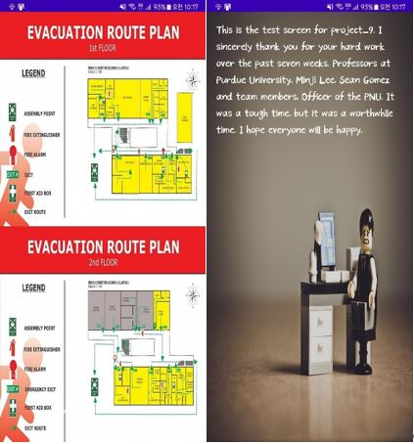
Implementation(General)
Main Screen
(Running application)
Example Contents
In “MAP”, “OURCOMPANY”

Slide 5
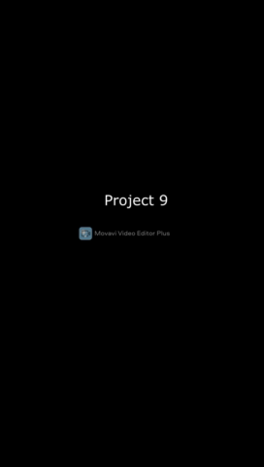
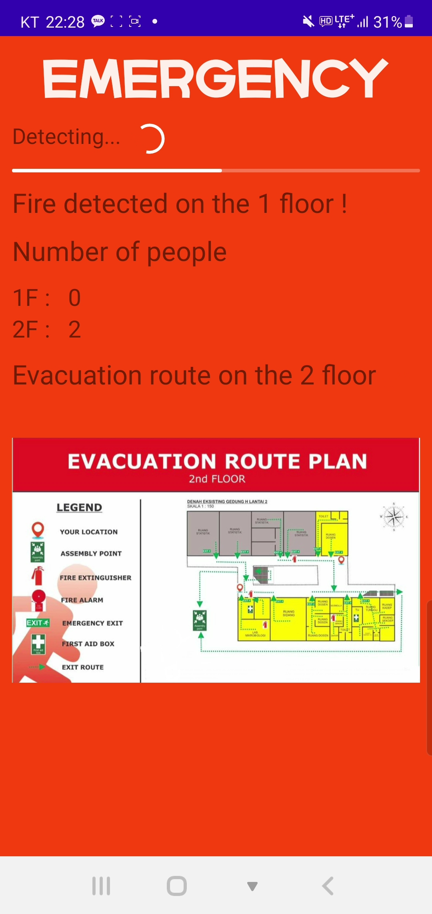
Implementation(In case of Fire)
Implementation Video
(In case of Fire)
App screen in a fire situation

Slide 6
Difficulty & Limit
Depending on the Type and Version of Beacon
Different Signal Strengths & Range of detection
In short
period time
(at Implementation)
Can’t get a Signal
(from a particular coordinate)
Overlapping Signals

Slide 7
Solution(Improvement)
Placing
Beacons
Predicting the appropriate distance
If multiple signals are detected
(at the same time)
Modifying
code
Reject the Update
Except for the first signal
The probability of malfunctioning (overlapping) has been significantly reduced

Slide 8
Future Plans
To use in real life
Improved security
encrypting the data stored
(in the database)
Have more Sensors
Detect more Disasters
(Earthquakes, Building collapses, etc.)

Slide 9
Thank you!
Taehoon Ha
Project 9
Pusan National University
hth1998@pusan.ac.kr

